Slide 1
Pompe: Byzantine Ordered Consensus without Byzantine Oligarchy
Name: Tanisha Fonseca
Student Id : 40266436
Coen 6731: Distributed Software Systems

Slide 2
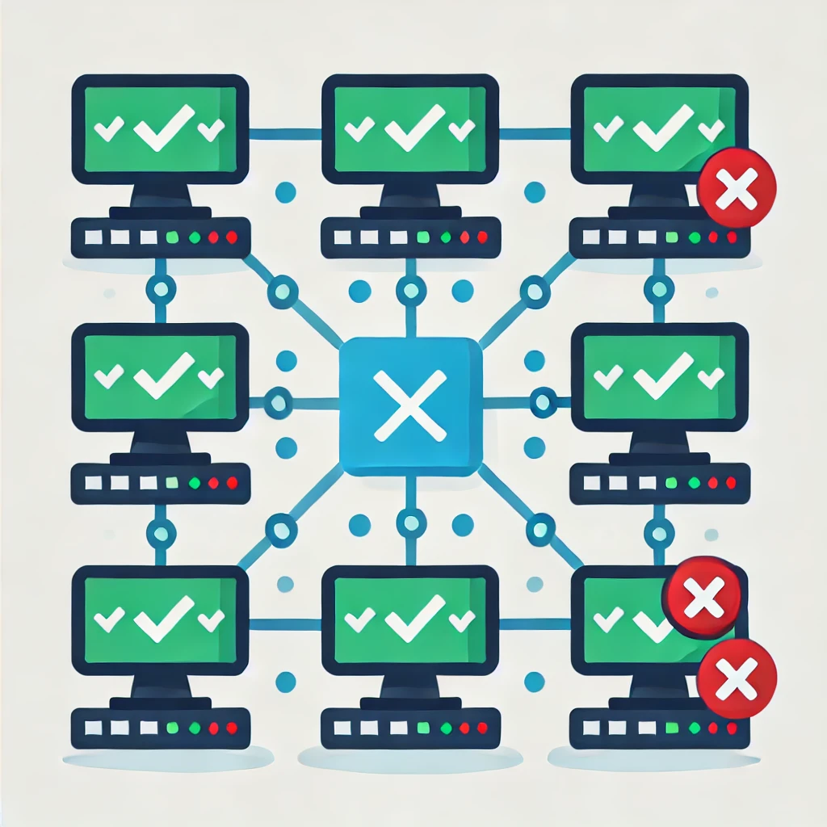
Overview:
Byzantine Ordered Consensus (BOC)
Oligarchy
A small group of people having control over the system or organization
It refers to a consensus mechanism ensures agreement while enforcing a tamper-resistant transaction order, even in the presence of Byzantine nodes.

Slide 3
Front Running
In 2020, 6M$ were lost in Ethereum due to bot reaping by unsuspected parties

Slide 4
Traditional SMR Systems
SMR is used for is fault-tolerance, the specific sequence of states that correct replicas traverse is immaterial
SMR orders client requests by running consensus for each position, ensuring all correct client requests are included (liveness).
Consider, for instance, permissioned blockchains like Libra, CCF , or Hyperledger Fabric : the specific order of transactions held by their ledger can have significant financial implications

Slide 5
Introduction
A key challenge is that the lack of expressiveness in the correctness specification of SMR has deep architectural roots.
This paper aims to add a new dimension to SMR by introducing a way to express, reason about, and enforce specific properties about how the SMR protocol orders the commands it receives.
There are two-pronged approach:
For expressiveness, we expand the correctness specification of the BFT SMR.
For enforcement, we articulate a new architecture for BFT replication that makes it possible to implement in practice our newly-introduced correctness requirements.

Slide 6
Leader has the Upper hand
What specific order of commands is desirable?
Rotating leader
Single leader has significant influence over command in system.
Protocol relies on consensus within batches of commands , which can be influenced.

Slide 7
Goals :
Specifically, the goal is to introduces an approach to rigorously define and enforce a valid total order of transactions in blockchain systems.
The paper makes four key contributions:
Expanding
Expanding the SMR specification to explicitly express ordering requirements
Exploring
Exploring the influence of Byzantine nodes on the final total order.
Designing
Designing a new modular architecture for SMR that supports this Order Consensus.
Implementing and evaluating
Implementing and evaluating Pompe , that offers competitive performance with existing systems.

Slide 8
Architecture Glimpse
Single Leader
Ordering Phase
Consensus Phase
Single Leader has significant influence over command position on entire system
The leader has control and can manipulate the system
A separate process is responsible for determining the relative order of commands which commands should come first, second, and so on.
The consensus step focuses solely on agreeing on which commands, should be included in the ledger.

Slide 9
Ordering Indicators
Proposals are submitted as ⟨o, c⟩,
The ordering indicator specifies the position or priority of a command in the sequence.
The command is the operation or action that needs to be performed (e.g., a transaction in a blockchain).
(e.g., timestamps, sequence numbers, dependency graphs).
An order-before relation (≺ₒ) is defined such that for proposals ⟨o₁, c₁⟩ and ⟨o₂, c₂⟩, o₁ ≺ₒ o₂ implies a preference to order c₁ before c₂.

Slide 10
Profiles, Executions & Traces:
A profile is the collection of all ⟨o, c⟩ proposals;
Pᵢ denotes proposals from node i, and P_C represents proposals from all correct nodes.
In an execution, correct nodes use proposals from P_C while Byzantine nodes and the network are controlled by an adversary.
Different execution traces can occur from the same profile, potentially leading to different ledger orders due to adversarial actions
This variability raises the question: How much influence can Byzantine nodes exert on the final ordering?

Slide 11
Expanding the SMR specification
Node 1 : C1 < C2 < C3 < C4
Node 2 : C2 < C3 < C4 < C1
Node 3 : C3 < C4 < C1 < C2
Node 4 : C4 < C1 < C2 < C3
C1<C2
<C3<C4
C1<C2
<C4<C3
C4<C1<C2<C3
NODE 1
NODE 2
NODE N
Each node has their own preferences, and the command ordering are decided based on timestamps.
Condorcet cycle

Slide 12
Ordering Unanimity
Ordering Unanimity simply means that if all the correct nodes agree on the relative order of two commands, then that order must be reflected in the final ledger.
C1<C2
<C3<C4
C1<C2
<C4<C3
C1<C2<C3<C4
In this case, all nodes agree that c1 comes before c2, hence it will be reflected in ledger.
NODE 1
NODE 2
NODE 3

Slide 13
The Influence of Byzantine Nodes
Byzantine Influence : While the influence cannot be completely eliminated, we can minimize their control over the ordering process.
Ordering Linearizability : The key contribution is the concept of ordering linearizability , which ensures that the sequence of commands respects the order defined by timestamps.
Using Timestamps for Order : The order of commands is determined based on timestamps provided by the correct nodes , creating a valid total order .

Slide 14
Ordering Linearizability
let O1 = {o1|⟨o1,c1⟩ ∈ PC} and
O2 = {o2|⟨o2,c2⟩ ∈ PC},
If o1 ≺o o2 holds for all o1 ∈ O1 and o2 ∈ O2, then c1 must precede c2 in the ledgers of correct nodes.
Informally, it ensures that if the lowest timestamp that any correct node assigns to command c2 is larger than the highest timestamp that any correct node assigns to c1, then c1 will precede c2 in the ledger.
(01:07:540)
lowest timestamp for c2
Cmd 1
Cmd 2
Highest timestamp for c1
(01:05:100)

Slide 15
Pompe: New Architecture for BFT-SMR
Ordering Phase: the ordering interface ensures that commands are correctly ordered, independent of the consensus phase.
Consensus Phase: The consensus phase is focused only on deciding the prefix of the ledger and does not need to worry about the order of commands.
Flexibility & Agnosticism: This new architecture is agnostic to the consensus mechanism used, meaning it can accommodate different consensus approaches. It allows systems to use leader-based protocols without worrying about the possibility of order manipulation by Byzantine nodes.

Slide 16
System Description
Distributed System Assumptions
Cryptographic Assumptions
Adversarial Network Model
Timing Assumptions
The system consists of n = 3f + 1 nodes, where f nodes may be Byzantine, and the remaining nodes are correct.
Use digital signatures for authentication.
Collision-resistant hash functions ensure message integrity.
The network can drop, reorder, or delay messages. Liveness is ensured under a weak synchrony assumption
Each node has a monotonically increasing timer to generate timestamps for ordering commands.

Slide 17
Ordering phase
Step 1: The Broadcast Requests for timestamps from a quorum.
Node Ni with a command c collects signed timestamps on c from a quorum of 2f + 1 nodes.
Median Timestamp is calculated.
Step 2: Broadcast Sequence message with the assigned timestamp.
Wait for quorum response to accept the command.
Round trip 2 : write the median timestamp for 2f + 1 nodes
Proposer
Nodes
Round trip 1 : collect timestamps

Slide 18
Consensus Phase
The Consensus Phase in Pompē is responsible for ensuring that all correct nodes agree on a stable prefix of the total order of commands that was established in the Ordering Phase.
The leader node is in charge of finalizing this sequence.
Since the order was already decided in the previous phase, the leader cannot manipulate it.
Key takeaway: Pompē still benefits from a leader-based approach (which is fast) without allowing a Byzantine oligarchy (where a small group manipulates order).

Slide 19
Consensus Phase
Pompē employs a leader-based Byzantine Fault-Tolerant (BFT) SMR protocol (e.g., PBFT, HotStuff) to achieve agreement on the values in each consensus slot.
Time-Based Consensus Slot Mapping
Each consensus slot corresponds to a fixed time interval.
Example: Slot k has an interval [ts, ts′) (e.g., [0, 100ms), [100ms, 200ms), etc.).
Liveness and Synchronization Assumptions
Requires a bound Δ, which covers:
Δ1: Time for a Sync message to propagate.
Δ2: Time to complete the ordering phase.
During synchronization, all correct nodes receive Sync messages and adjust timers accordingly

Slide 20
Consensus Execution: Steps to Reach Agreement
Step 1: Leader Collects Inputs
Leader node broadcasts request for inputs (Collect message).
Nodes respond only if: They are synchronized with the system. Sufficient time has passed for updates.
Nodes send back their commands (CollectResponse message).
Step 2: Leader Runs Consensus
Leader combines responses into a final command set. Runs the consensus protocol to get agreement.
Step 3: Finalizing the Ledger
Commands are sorted by timestamp. And executed in a fixed order

Slide 21
Variants Of Pompe
Two variants of Pompē by extending existing state-of-the-art leader-based Byzantine Fault Tolerant (BFT) protocols:
Pompē-HotStuff: Based on HotStuff, a protocol that uses a rotating leader paradigm and serves as the foundation for the Libra blockchain.
Pompē-SBFT: Built upon VMware's Concord, which implements a variant of PBFT (Practical Byzantine Fault Tolerance) with scalability optimizations.

Slide 22
Message-passing workflow of determining an order

Slide 23
Theorems and Lemmas
Consistency (Theorem 4.1): All correct nodes maintain identical logs.
Validity (Theorem 4.2): Only proposed commands appear in the ledger.
Timestamp Bounds (Lemma 4.1): Byzantine nodes cannot manipulate timestamps.
Ordering Guarantees (Theorem 4.3): Earlier commands always appear first.
Eventual Inclusion (Lemmas 4.2 & 4.3): Proposed commands are guaranteed to be committed.
Strong Liveness (Theorem 4.4): Every correct node's command will be included in the total order.

Slide 24
Experimental Setup
1.1 Baseline Protocols: Concord (SBFT-based) and HotStuff are used as baselines because they represent state-of-the-art leader-based BFT consensus mechanisms.
1.2 Variants of Pompē: Pompē-HS → Extends HotStuff with Byzantine-tolerant ordering and Pompē-C → Extends Concord (SBFT) with Byzantine-tolerant ordering.
1.3 Testbed
Experiments are conducted on 100 Azure Standard D16s_v3 VMs (16 vCPUs, 64GB RAM each).
Three geographically distributed datacenters: West US (34 VMs), outheast Asia (33 VMs),North Europe (33 VMs)
1.4 Workload
HotStuff & Pompē-HS: Clients submit random 32-byte commands (as in prior work [67]).
Concord & Pompē-C: A key-value store benchmark is used, where random values are written to random keys

Slide 25
Pompē and HotStuff in a geo-distributed setting.
Observation: Latency remains relatively stable until system saturation (~300,000 cmds/s).
Percentiles :Higher percentiles (99%) experience slightly worse latency than lower ones (50%), indicating that some commands take longer to be ordered.
Observation: Latency remains stable across different throughput levels.
Percentiles: The latency gap between 50%, 90%, and 99%
is smaller than in HotStuff, indicating more predictable performance.
Notes:
Hotstuff: observation: Initially, as throughput increases, latency decreases because more clients fill batches faster. However, once the system is saturated (~6,000 cmds/s), latency spikes due to network delays in geo-distributed settings.
Percentiles: The 99% latency is much higher than 50% and 90%, meaning some commands experience extreme delays.

Slide 26
Throughput and Latency Pompē-HS vs. HotStuff
Peak throughput and median latency of different configurations of Pompe-HS and of HotStuff as a function of the number of nodes (n) in a geo-distributed deployment.
The light blue cross at n = 31 depicts the performance of Pompe-HS (scale up) with 3 VMs per
node; the blue square above it shows the predicted throughput when each node is assigned ⌊31/4⌋ = 7 VMs.

Slide 27
Scalability of Pompē-C and Concord in a geo-distributed deployment

Slide 28
Key Results and Analysis
Latency :
Pompē reduces the impact of Byzantine nodes on ordering latency since Byzantine nodes cannot affect ordering once timestamps are assigned.
Consensus latency in Pompē is slightly higher than the baselines due to the additional step of enforcing Byzantine-tolerant ordering.
Pompē-HS has lower latency than Pompē-C because HotStuff’s rotating leader paradigm reduces bottlenecks compared to Concord's static leader approach.

Slide 29
Throughput Results
Pompē achieves higher peak throughput than baselines because ordering is decoupled from consensus.
Pompē-HS achieves better throughput than Pompē-C due to HotStuff’s leader rotation (reducing leader bottlenecks).
When Byzantine nodes are present, Pompē maintains higher throughput stability because Byzantine nodes cannot manipulate the ordering phase.

Slide 30
Related Work in BFT
Approach | What It Does | Problems | How Pompe Improves
Leader-Based BFT | Uses a leader to order and propose transactions | Byzantine leaders can manipulate order | Separates ordering from consensus
Leaderless BFT (Lamport’s, DBFT, EPaxos) | Removes a fixed leader to reduce Byzantine influence | High latency, still prone to manipulation | Ensures fair ordering with independent timestamps
HoneybadgerBFT, Helix | Encrypts transactions to prevent censorship | Byzantine nodes can still filter metadata | Guarantees transaction inclusion based on timestamps
Order Fairness (Kelkar et al.) | Tries to maintain fairness in order selection | Requires high resource usage | Ensures fairness without extra resource overhead
Permissionless BFT Blockchains | Uses VRFs or stake for selection | May still suffer from ordering attacks | Pompē can be used as a secure ordering mechanism
Social Choice Theory Applications | Applies voting fairness to BFT ordering | Byzantine nodes can still manipulate consensus | Defines Byzantine oligarchy and democracy to ensure fairness

Slide 31
Strengths
Separation of Ordering and Consensus
Resilience Against Byzantine Dictatorship: Pompē introduces Byzantine democracy, reducing the influence of Byzantine nodes on consensus.
Scalability and Efficiency: The experimental results show that Pompē-C outperforms Concord in both throughput and latency.
Generalized Design for Blockchain: Suitable for geo-distributed deployments, making it useful for applications like food supply chains or financial systems.
Improved Censorship Resistance: Prevents Byzantine nodes from filtering transactions based on metadata.

Slide 32
Weakness
Does Not Fully Eliminate Byzantine Influence
Although it reduces manipulation, Byzantine nodes can still bias timestamps.
Increased Complexity
The separation of ordering and consensus introduces additional steps, increasing protocol complexity.
Could require more computational and network resources than simpler BFT designs.
Limited Protection Against Network Adversaries
Assumes a partially synchronous network but does not fully defend against adversaries who control the entire network. Such adversaries can selectively delay messages and bias order assignments.
Lack of Built-in Replay Protection
Does not prevent duplicate commands in the transaction order.
Developers must add extra metadata to prevent replay attacks.

Slide 33
Online Ticket Booking System
Problem: A malicious server could reorder transactions, giving VIP customers or bots unfair priority over regular users.
How Pompē Fixes It:
Separation of Ordering & Consensus
Fairness Guaranteed: The system orders transactions based on real timestamps not when a server processes them.
No Manipulation
Outcome:
Everyone gets tickets fairly based on when they actually placed the order, preventing manipulation by a corrupt server.

Slide 34
Banking Transactions with Pompē
Problem: Traditional leader-based systems risk fraudulent reordering of transactions.
A malicious bank may delay or manipulate transactions for unfair advantage.
Example: 1. Alice transfers $100 to Bob at 10:00:00 AM (from Bank A). 2. Bob withdraws $50 at 10:00;01 AM (from Bank B).
3. Byzantine nodes cannot alter this order, ensuring fairness.
Pompē Solution: Fair ordering: Transactions are ordered based on timestamps, not controlled by one leader. Secure consensus: Once ordered, transactions are validated collectively, preventing manipulation.

Slide 35
References
OSDI '20 - Byzantine ordered consensus without Byzantine oligarchy
Reaching Consensus in the Byzantine Empire: A Comprehensive Review of BFT Consensus Algorithms
Pompe Implemetation Using GoLang

Slide 36
Any questions?

