Slide 1
The Honey Badger of BFT Protocols
An Asynchronous Byzantine Fault Tolerance Approach
COEN 6731 – Distributed Software
Mahdi Yousefan Najafabadi – 40244109
Alireza Mazloumi Soveini – 40266707
1

Slide 2
Agenda
1
Background & Motivation
2
Key Techniques
Context and need for asynchronous BFT protocols
ACS, Threshold Encryption, and Batching mechanisms
3
Architecture & Implementation
4
Evaluation & Analysis
System design and technical implementation details
Performance results and critical assessment
2

Slide 3
Background and Motivation
Rising Demand
Traditional Limitations
Critical Applications
Cryptocurrencies and decentralized systems need robust fault tolerance.
PBFT and similar protocols assume synchrony, failing in unpredictable networks.
Financial and mission-critical systems require guaranteed liveness.
3

Slide 4
Asynchronous Common Subset (ACS)
Node Proposals
Each node proposes a value to the network
Asynchronous Agreement
Nodes communicate without timing assumptions
Common Subset
At least N-f proposals included in final set
4

Slide 5
Threshold Encryption
Encrypt Proposals
Secure Agreement
Nodes encrypt transaction batches to prevent censorship
ACS protocol agrees on encrypted proposals
Reveal Transactions
Threshold Decryption
Proposals decrypted only after agreement
At least f+1 nodes must contribute decryption shares
5

Slide 6
Batching Mechanism
Transaction Buffer
Each node maintains a queue of pending transactions
Random Selection
Randomly sample transactions to create a batch
Batch Size
Size B tuned to maximize throughput and efficiency
6

Slide 7
High-Level Architecture
Consensus Layer
Final agreement on transaction ordering
Node Processing
ACS, RBC, BA, and Threshold Encryption
Client Input
Transaction submission from external clients
7

Slide 8
Protocol Breakdown Overview
Transaction Collection
Nodes gather and encrypt transaction batches
Agreement via ACS
Nodes agree on set of encrypted proposals
Threshold Decryption
Nodes contribute shares to decrypt agreed proposals
Commit
Transactions ordered and committed to ledger
8

Slide 9
Asynchronous Common Subset (ACS) Details
Purpose
Components
Aggregates proposals from at least N-f nodes despite asynchrony
Built using Reliable Broadcast (RBC) and Binary Agreement (BA)
9

Slide 10
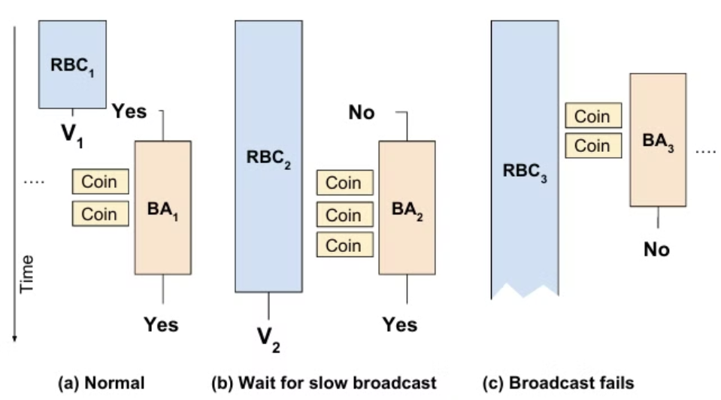
RBC & Binary Agreement
Reliable Broadcast (RBC)
Binary Agreement (BA)
Guarantees consistent message delivery
Achieves consensus on binary values
Uses erasure coding for efficiency
Utilizes common coin techniques
Ensures all honest nodes receive same message
10

Slide 11
Threshold Encryption Integration
Encryption
Encrypting proposals to prevent adversarial censorship
Decryption
At least f+1 shares combined to reveal transaction batches
Ensuring
Ensures proposals are fixed before adversaries can interfere
11

Slide 12
Implementation Details
Python with gevent
Cryptographic Libraries
Erasure Coding
Communication
zfec library for efficient Reed-Solomon codes
TCP with TLS recommended for production
Concurrency library for asynchronous operations
Charm and PBC for threshold encryption/signatures
12

Slide 13
Evaluation Setup
Amazon EC2 Deployment
Nodes distributed across 5 continents for realistic testing
Tor Network Testing
Evaluation in highly adversarial network conditions
Configuration Parameters
N nodes (N = 4f), varying batch sizes for comprehensive analysis
Key Metrics
Throughput (tx/sec), latency, communication overhead
13

Slide 14
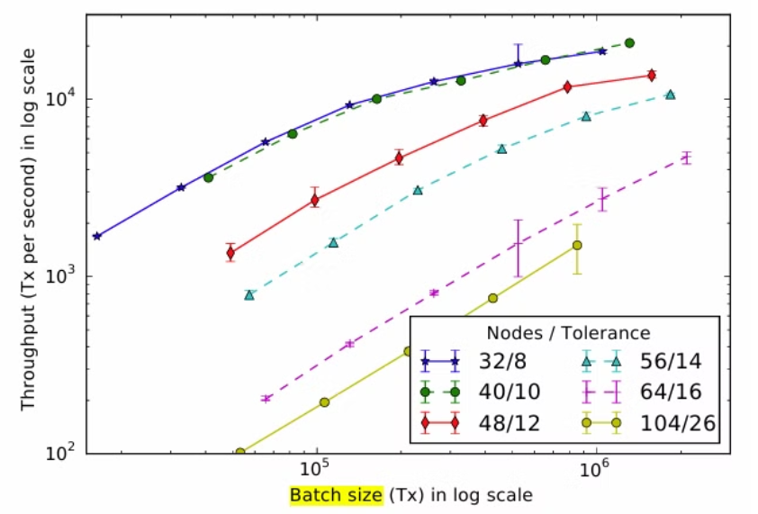
Performance Results – Throughput
20,000+
~1,500
Scaling
Transactions/sec
Transactions/sec
Better Scaling
Throughput on 40-node networks
Throughput on 104-node networks
More graceful degradation compared to PBFT
14

Slide 15
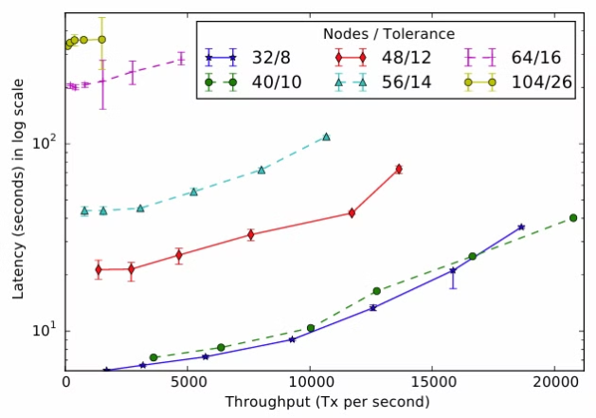
Performance Results – Latency
1
Latency increases with network size due to the Binary Agreement phase
2
Trade-off: Higher batch sizes reduce per-transaction cost but may increase delay
3
Consistent progress despite network adversities
15

Slide 16
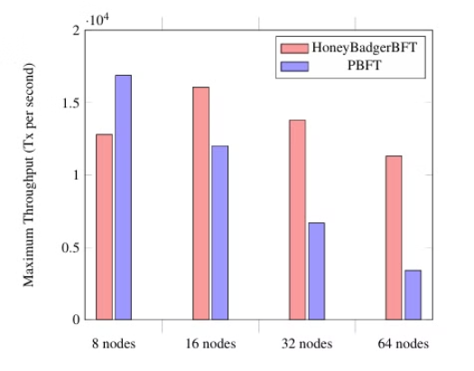
Performance Results – Comparison with PBFT
1
PBFT suffers from leader bottlenecks and decreased throughput with scaling
2
HoneyBadgerBFT distributes load evenly across nodes
3
Clear performance advantage in asynchronous environments
16

Slide 17
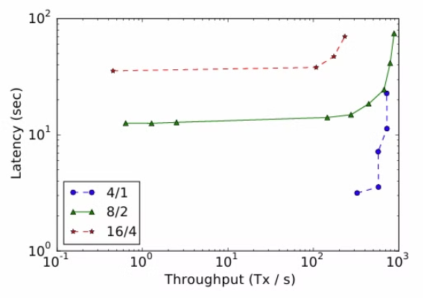
Performance Results – Tor Experiments
1
Experiments over Tor demonstrate robust performance under high and variable latency
2
Achieved throughput of ~800 tx/sec despite Tor’s inherent delays
3
Highlights protocol’s resilience in anonymity networks
17

Slide 18
Critical Analysis - Strengths
Scalability
Effective batching and load distribution lead to high throughput
Innovative Design
First practical asynchronous BFT protocol eliminating timing assumptions
Robustness
Maintains performance in adversarial conditions and under network variability
18

Slide 19
Critical Analysis - Weaknesses
Assumptions
Requires full input buffers and a trusted setup phase, which may not hold in all deployments
Complexity
Integration of multiple cryptographic primitives and sub-protocols makes the design intricate
Scalability Limits
Communication overhead grows quadratically with node count, potentially limiting performance in very large networks
19

Slide 20
Conclusion
Future Directions
Real-World Impact
Simplifying implementation and reducing communication overhead
Key Innovations
Implications for decentralized and financial systems
Significant Contribution
ACS, threshold encryption, and batching
HoneyBadgerBFT’s contributions to asynchronous consensus
20

Slide 21
Thank You
Questions?
We welcome your insights and inquiries about HoneyBadgerBFT
21

